Slide 1
Week 9
Empirical and molecular formulas

Slide 2
The empirical formula of any compound is the simplest whole number ratio in which the atoms of the elements are present.
E.g. The compound hydrogen peroxide has the molecular formula H₂O₂. It is composed of two atoms of hydrogen and two atoms of oxygen bonded together. The empirical formula of hydrogen peroxide is HO because this is simplest whole number ratio.
However, for water(H₂O), the empirical and molecular formulas are the same.

Slide 3
The empirical formula of a substance can be determined experimentally. The term ‘empirical’ means obtained from experiment.
This can be done by experimentally determining the percentage composition and then applying the mole concept to determine the ratio of particles.
Molecular formula states the actual number of each type of atom present in the molecule.

Slide 4
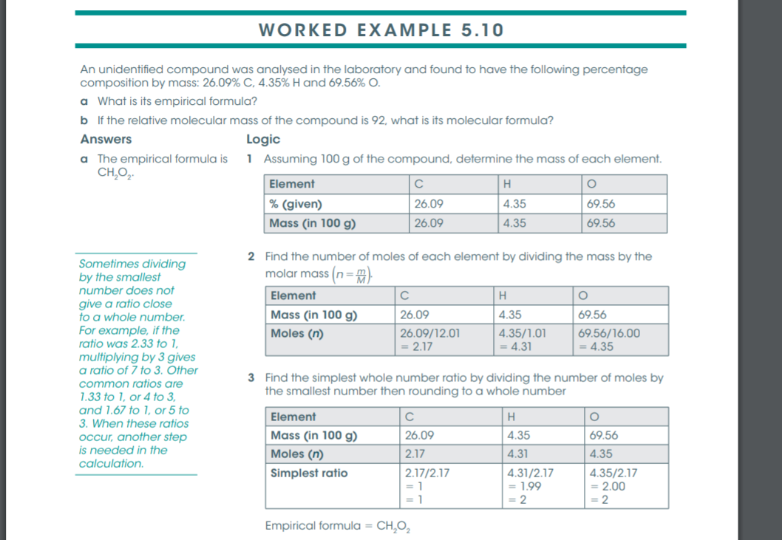

Slide 5
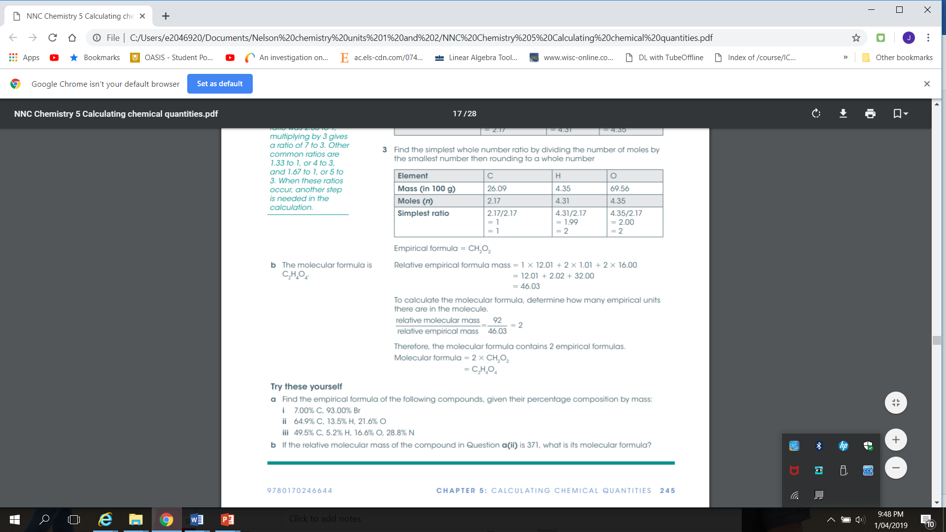

Slide 6
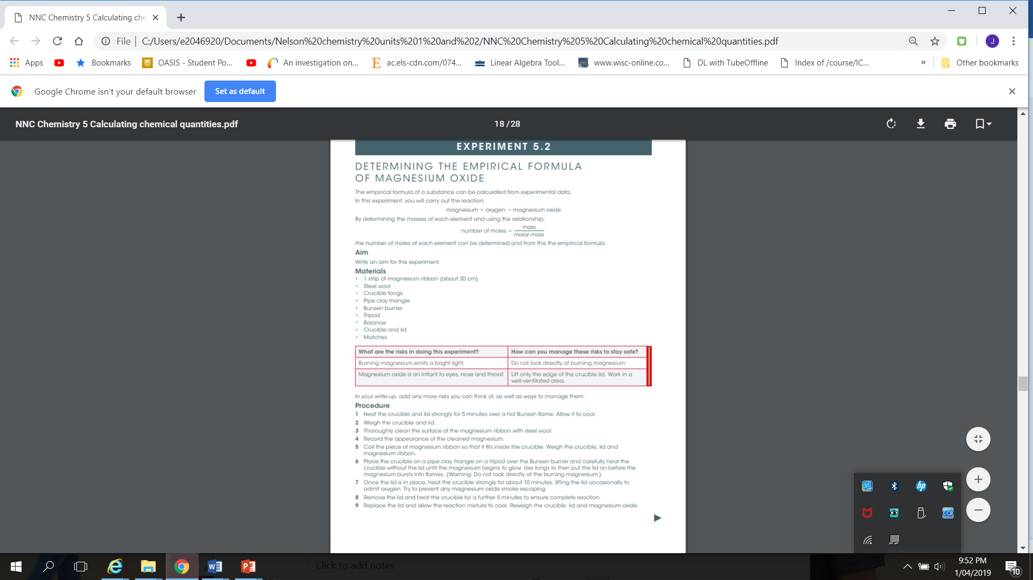

Slide 7


